Slide 1

#LifeKoKaroLift
Java
Program
<number>
05/01/2021

Slide 2



Course : Java Program
Lecture On : Variables & Datatypes
Instructor : Rahul Kumar
05/01/2021
<number>

Slide 3
Today’s Agenda
1.) Installation of JDK
2.) Variables
3.) Strings and characters
4.) Comments in Java
05/01/2021
Java Program
<number>
Notes:
<number>

Slide 4
Installation of JDK
Downloading the JDK Installer
In a browser, go to the Java SE Development Kit 10 Downloads page and click Accept License Agreement. Under the Download menu, click the Download link that corresponds to the .exe for your version of Windows.
Download the file jdk-10.interim.update.patch_windows-x64_bin.exe.
Running the JDK Installer
Start the JDK 10 installer by double-clicking the installer's icon or file name in the download location.
Follow the instructions provided by the Installation wizard.The JDK includes the JavaFX SDK, a private JRE, and the Java Mission Control tools suite. The installer integrates the JavaFX SDK into the JDK installation directory.
05/01/2021
<number>

Slide 5
Installation of JDK
Setting the PATH Environment Variable
If you do not set the PATH variable, then you must specify the full path to the executable file every time that you run it. For example:
C:\> "C:\Program Files\Java\jdk-10\bin\javac" MyClass.java
To set the PATH variable permanently, add the full path of the jdk-10\bin directory to the PATH variable. Typically, the full path is:
C:\Program Files\Java\jdk-10\bin
To set the PATH variable on Microsoft Windows:
Select Control Panel and then System.
Click Advanced and then Environment Variables.
Add the location of the bin folder of the JDK installation to the PATH variable in System Variables
The following is a typical value for the PATH variable:
C:\WINDOWS\system32;C:\WINDOWS;"C:\Program Files\Java\jdk-10\bin"
05/01/2021
4

Slide 6
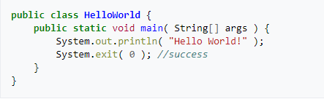
The ‘Hello World’ Program on Command Prompt
Type this program up in your text editor and save it as HelloWorld.java. Go to your console window (in Windows, go to the start menu and click "run", then type "cmd.exe"; in Linux, open a terminal).
Use the cd command (cd dirname or .. to go up one directory) to navigate to the directory where HelloWorld.java was saved. Compile the program using the command javac HelloWorld.java.
Remember that Java is case-sensitive, so even when you compile your program, you have to make sure you are typing in the file name exactly.
Compiling the program will produce the file HelloWorld.class, the JVM version of your program. This code is machine independent.
05/01/2021
5

Slide 7
Integrated Development Environment (IDE) - IntelliJ
Install IntelliJ IDEA manually to manage the location of every instance and all the configuration files. For example, if you have a policy that requires specific install locations.
Download the installer .exe .
Run the installer and follow the wizard steps.
On the Installation Options step, you can configure the following:
Create a desktop shortcut for the launcher relevant to your operating system
Add the directory with IntelliJ IDEA command-line launchers to the PATH environment variable to be able to run them from any working directory in the Command Prompt
Add an item Open Folder as Project to the system context menu (when you right-click a folder)
Associate specific file extensions with IntelliJ IDEA to open them with a double-click
Install the 32-bit version of JetBrains Runtime if you are running a 32-bit Windows version
05/01/2021
5

Slide 8
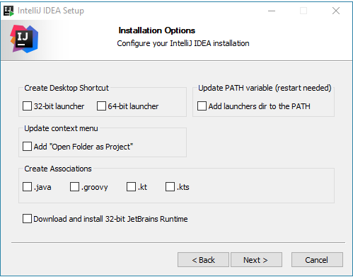
Integrated Development Environment (IDE) - IntelliJ
05/01/2021
5

Slide 9
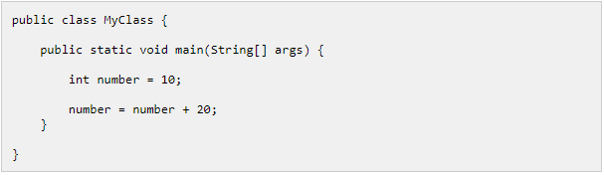
Variables
A Java variable is a piece of memory that can contain a data value. A variable thus has a data type.
Variables are typically used to store information which your Java program needs to do its job. This can be any kind of information ranging from texts, codes (e.g. country codes, currency codes etc.) to numbers, temporary results of multi step calculations etc.
In the code example below, the main() method contains the declaration of a single integer variable named number. The value of the integer variable is first set to 10, and then 20 is added to the variable afterwards.
05/01/2021
5

Slide 10
Variables
Java Variable Types
In Java there are four types of variables:
Non-static fields
Static fields
Local variables
Parameters
A non-static field is a variable that belongs to an object. Objects keep their internal state in non-static fields. Non-static fields are also called instance variables, because they belong to instances (objects) of a class.
A static field is a variable that belongs to a class. A static field has the same value for all objects that access it. Static fields are also called class variables.
A local variable is a variable declared inside a method. A local variable is only accessible inside the method that declared it.
A parameter is a variable that is passed to a method when the method is called. Parameters are also only accessible inside the method that declares them, although a value is assigned to them when the method is called.
05/01/2021
9

Slide 11
Variables
Java Variable Declaration
Exactly how a variable is declared depends on what type of variable it is (non-static, static, local, parameter). However, there are certain similarities that
In Java you declare a variable like this:
Instead of the word type, you write the data type of the variable. Similarly, instead of the word name you write the name you want the variable to have.
Here is an example declaring a variable named myVariable of type int.
05/01/2021
10

Slide 12
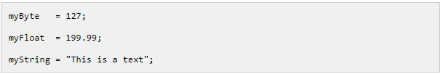
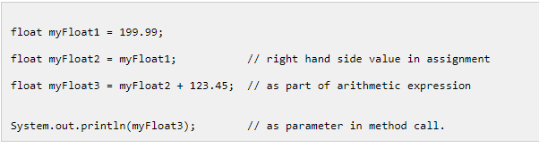
Variables
Java Variable Assignment
Assigning a value to a variable in Java follows this pattern:
variableName = value ;
Here are three concrete examples which assign values to three different variables with different data types
Java Variable Reading
You can read the value of a Java variable by writing its name anywhere a variable or constant variable can be used in the code. For instance, as the right side of a variable assignment, as parameter to a method call, or inside a arithmetic expression. For instance:
05/01/2021
11

Slide 13
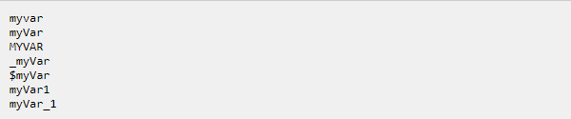
Variables
Java Variable Naming Conventions
There are a few rules and conventions related to the naming of variables.
The rules are:
Java variable names are case sensitive. The variable name money is not the same as Money or MONEY.
Java variable names must start with a letter, or the $ or _ character.
After the first character in a Java variable name, the name can also contain numbers (in addition to letters, the $, and the _ character).
Variable names cannot be equal to reserved key words in Java. For instance, the words int or for are reserved words in Java. Therefore you cannot name your variables int or for.
Here are a few valid Java variable name examples:
05/01/2021
12

Slide 14
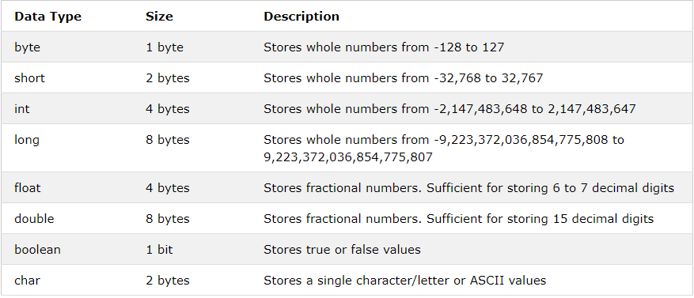
Variables
Primitive Data Types:
A primitive data type specifies the size and type of variable values, and it has no additional methods.
There are eight primitive data types in Java:
05/01/2021
13

Slide 15
Variables
Numbers:
Primitive number types are divided into two groups:
Integer types stores whole numbers, positive or negative (such as 123 or -456), without decimals. Valid types are byte, short, int and long. Which type you should use, depends on the numeric value.
Floating point types represents numbers with a fractional part, containing one or more decimals. There are two types: float and double.
Integer Types
Byte
The byte data type can store whole numbers from -128 to 127. This can be used instead of int or other integer types to save memory when you are certain that the value will be within -128 and 127:
05/01/2021
14

Slide 16
Variables
Short
The short data type can store whole numbers from -32768 to 32767:
Int
The int data type can store whole numbers from -2147483648 to 2147483647. In general, and in our tutorial, the int data type is the preferred data type when we create variables with a numeric value.
Long
The long data type can store whole numbers from -9223372036854775808 to 9223372036854775807. This is used when int is not large enough to store the value.
05/01/2021
15

Slide 17
Variables
Floating Point Types
You should use a floating point type whenever you need a number with a decimal, such as 9.99 or 3.14515.
Float
The float data type can store fractional numbers from 3.4e−038 to 3.4e+038. Note that you should end the value with an "f":
Double
The double data type can store fractional numbers from 1.7e−308 to 1.7e+308. Note that you should end the value with a "d":
05/01/2021
16

Slide 18
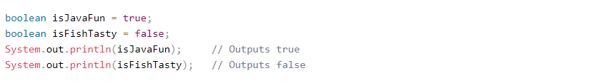
Variables
Booleans
A boolean data type is declared with the boolean keyword and can only take the values true or false:
Characters
The char data type is used to store a single character. The character must be surrounded by single quotes, like 'A' or 'c':
05/01/2021
17

Slide 19
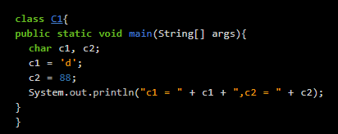
Strings and characters
Characters and String in Java
We interact with each other through words and sentences. So, there must be some way by which Java should also play with these words or sentences. And that is exactly what we are going to do in this chapter.
Characters
You all must be knowing about characters. In Java, the data type to store characters is char.
In Java, characters are represented using Unicode. Unicode is an international character set representing all the characters.
In Java, char ranges from 0 to 65,535.
Characters are always written within ' '.
Let's see an example.
05/01/2021
18

Slide 20
Strings and characters
Strings
We can think of a string as a collection of characters. In other words, it is an array of characters, like "Robin" is a string.
In Java programming, strings are objects. Before understanding it, let's first see how to declare a string.
String s = "Hello";
We can also declare it as
String s = {'h','e','l','l','o'};
Here, s is a string having the value Hello. s is an object of the class String.
Thus 's' is an String object having its value "Hello".
As stated that string is an array of characters, in the second example we are declaring string as an array of characters.
We can also create String objects using the new keyword. Here, the new keyword is used to create an object 's' of the class String. The following codes are used to create a String object 's' having its value "Hello".
String s = new String("Hello");
char ch = {'h','e','l','l','o'}; String s = new String(ch);
05/01/2021
19

Slide 21
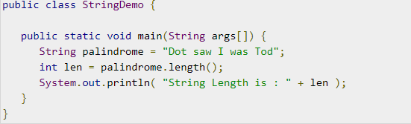
Strings and characters
String Length
Methods used to obtain information about an object are known as accessor methods. One accessor method that you can use with strings is the length() method, which returns the number of characters contained in the string object.
The following program is an example of length(), method String class.
This will produce the following result −
Output
String Length is : 17
05/01/2021
20

Slide 22
Strings and characters
Concatenating Strings
The String class includes a method for concatenating two strings −
string1.concat(string2);
This returns a new string that is string1 with string2 added to it at the end. You can also use the concat() method with string literals, as in −
"My name is ".concat("Zara");
Strings are more commonly concatenated with the + operator, as in −
"Hello," + " world" + "!"
which results in −
"Hello, world!“
There are many string methods which we will see in upcoming modules.
05/01/2021
21

Slide 23
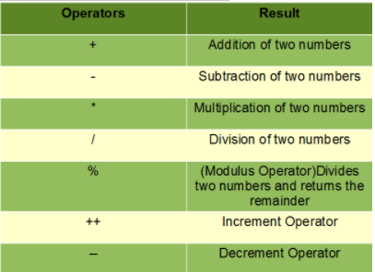
Arithmetic operations
These operators involve the mathematical operators that can be used to perform various simple or advance arithmetic operations on the primitive data types referred to as the operands. These operators consist of various unary and binary operators that can be applied on a single or two operands respectively. Let’s look at the various operators that Java has to provide under the arithmetic operators.
05/01/2021
22

Slide 24
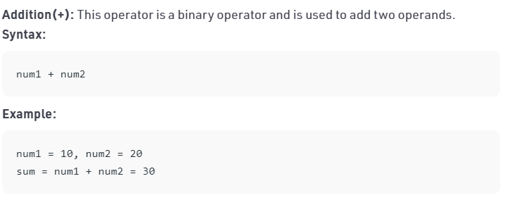
Arithmetic operations
These operators involve the mathematical operators that can be used to perform various simple or advance arithmetic operations on the primitive data types referred to as the operands. These operators consist of various unary and binary operators that can be applied on a single or two operands respectively. Let’s look at the various operators that Java has to provide under the arithmetic operators.
05/01/2021
23

Slide 25
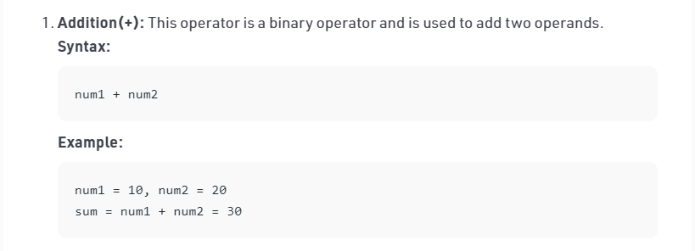
Arithmetic operations
These operators involve the mathematical operators that can be used to perform various simple or advance arithmetic operations on the primitive data types referred to as the operands. These operators consist of various unary and binary operators that can be applied on a single or two operands respectively. Let’s look at the various operators that Java has to provide under the arithmetic operators.
05/01/2021
<number>

Slide 26
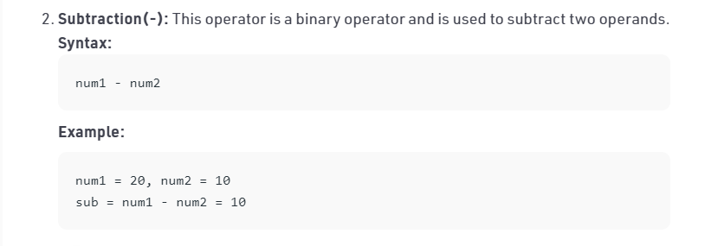
Arithmetic operations
05/01/2021
<number>

Slide 27
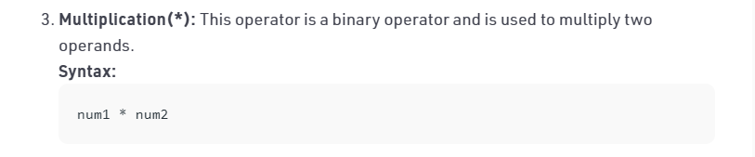
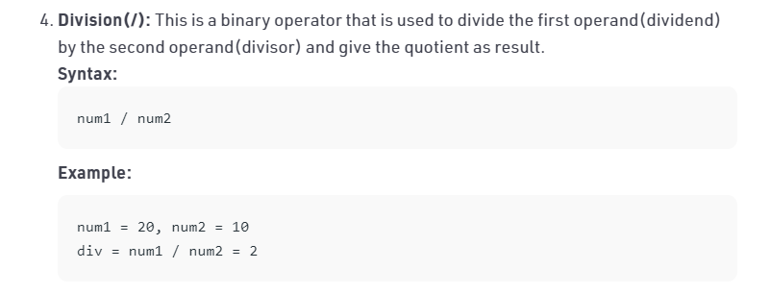
Arithmetic operations
05/01/2021
<number>

Slide 28
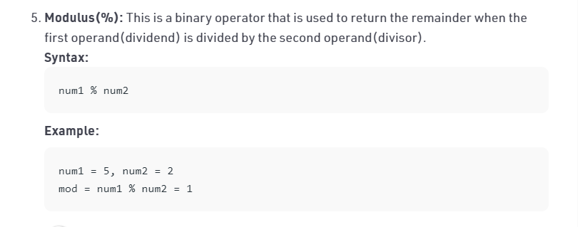
Arithmetic operations
05/01/2021
<number>

Slide 29
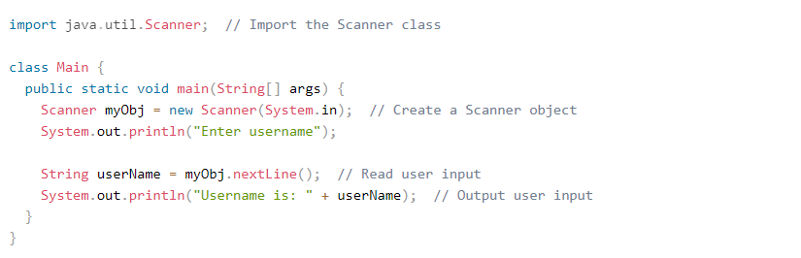
Taking user input in Java
The Scanner class is used to get user input, and it is found in the java.util package.
To use the Scanner class, create an object of the class and use any of the available methods found in the Scanner class documentation. In our example, we will use the nextLine() method, which is used to read Strings:
05/01/2021
<number>

Slide 30
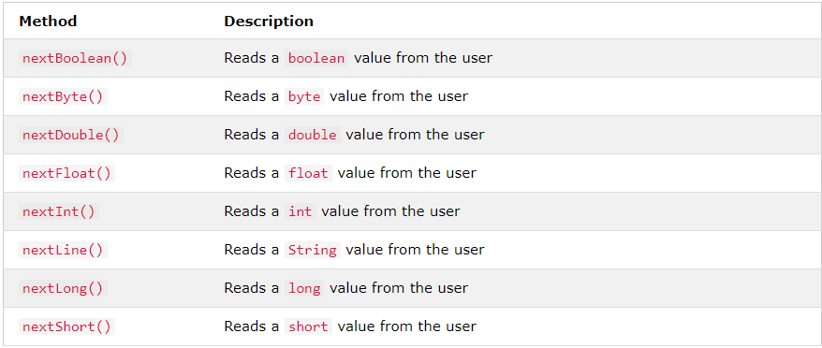
Taking user input in Java
Input Types
In the example above, we used the nextLine() method, which is used to read Strings. To read other types, look at the table below:
05/01/2021
<number>

Slide 31
Java Arrays
Arrays are used to store multiple values in a single variable, instead of declaring separate variables for each value.
To declare an array, define the variable type with square brackets:
We have now declared a variable that holds an array of strings. To insert values to it, we can use an array literal - place the values in a comma-separated list, inside curly braces:
To create an array of integers, you could write:
05/01/2021
<number>

Slide 32
Relational Operators in Java
Java has 6 relational operators
== is the equality operator. This returns true if both the operands are referring to the same object, otherwise false.
!= is for non-equality operator. It returns true if both the operands are referring to the different objects, otherwise false.
< is less than operator.
> is greater than operator.
<= is less than or equal to operator.
>= is greater than or equal to operator.
Example in next slide:
05/01/2021
<number>

Slide 33
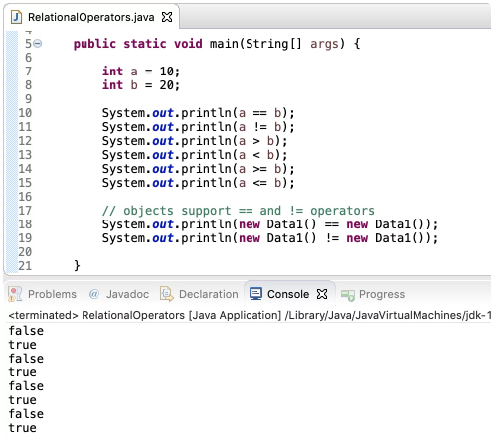
Relational Operators in Java
05/01/2021
<number>

Slide 34
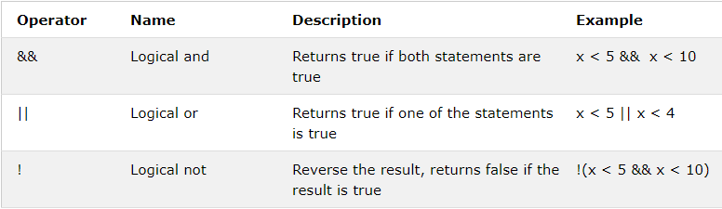
Java Logical Operators
Logical operators are used to determine the logic between variables or values:
05/01/2021
<number>

Slide 35
Errors while coding in Java
No matter how smart or how careful you are, errors are your constant companion. With practice, you will get slightly better at not making errors, and much, much better at finding and correcting them.
There are three kinds of errors: syntax errors, runtime errors, and logic errors.
Syntax errors
These are errors where the compiler finds something wrong with your program, and you can't even try to execute it. For example, you may have incorrect punctuation, or may be trying to use a variable that hasn't been declared.
Syntax errors are the easiest to find and correct. The compiler will tell you where it got into trouble, and its best guess as to what you did wrong. Usually the error is on the exact line indicated by the compiler, or the line just before it; however, if the problem is incorrectly nested braces, the actual error may be at the beginning of the nested block.
05/01/2021
<number>

Slide 36
Errors while coding in Java
Runtime errors
If there are no syntax errors, Java may detect an error while your program is running. You will get an error message telling you the kind of error, and a stack trace that tells not only where the error occurred, but also what other method or methods you were in. For example,
Exception in thread "main" java.lang.NullPointerException
at Car.placeInCity(Car.java:25)
at City.<init>(City.java:38)
at City.main(City.java:49)
This says that a NullPointerException was detected in the method placeCarInCity at line 25 in Car.java, which was called from the constructor for City at line 38 in City.java, which was called from the main method at line 49 in City.java. Sometimes there will be additional lines describing methods in the Java system itself; you can ignore these.
Runtime errors are intermediate in difficulty. Java tells you where it discovered that your program had gone wrong, but you need to trace back from there to figure out where the problem originated.
05/01/2021
<number>

Slide 37
Errors while coding in Java
Logic errors
A logic error, or bug, is when your program compiles and runs, but does the wrong thing. The Java system, of course, has no idea what your program is supposed to do, so it provides no additional information to help you find the error.
Ways to track down a logic error include:
Think about what the program must have done in order to produce the results it did. This will lead you to where the error must have occurred.
Put in print statements to help you figure out what the program is actually doing.
Use a debugger to step through your program and watch what it does.
05/01/2021
<number>

Slide 38


Comments in Java
Java Comments
Comments can be used to explain Java code, and to make it more readable. It can also be used to prevent execution when testing alternative code.
Single-line comments
Single-line comments start with two forward slashes (//).
Any text between // and the end of the line is ignored by Java (will not be executed).
This example uses a single-line comment before a line of code:
This example uses a single-line comment at the end of a line of code:
05/01/2021
<number>

Slide 39

Comments in Java
Java Multi-line Comments
Multi-line comments start with /* and ends with */.
Any text between /* and */ will be ignored by Java.
This example uses a multi-line comment (a comment block) to explain the code:
05/01/2021
<number>

Slide 40
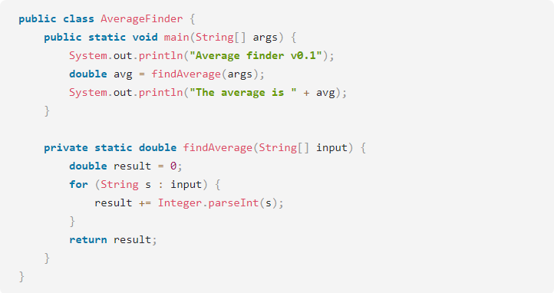
Debugging using the debugger tool provided by IntelliJ
Let's try a simple debugging case. Imagine we have the following application:
05/01/2021
<number>

Slide 41
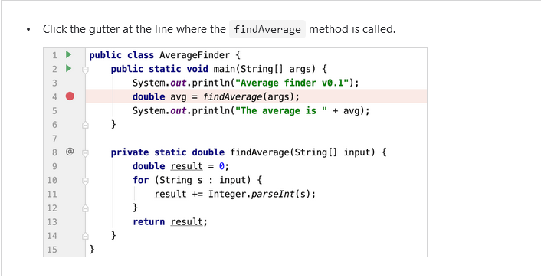
Debugging using the debugger tool provided by IntelliJ
The program is supposed to calculate the average of all values passed as command-line arguments.
It compiles and runs without issues, however the result is not what one would expect. For instance, when we pass 1 2 3 as the input, the result is 6.0.
First of all, you need to think about where the suspected error might be coming from. We can assume the problem is not in the print statements. Most likely, unexpected results are coming from our findAverage method. In order to find the cause, let's examine its behavior at runtime.
Set breakpoints ﻿
To examine how the program operates at runtime, we need to suspend its execution before the suspected piece of code. This is done by setting breakpoints. Breakpoints indicate the lines of code where the program will be suspended for you to examine its state.
05/01/2021
<number>

Slide 42
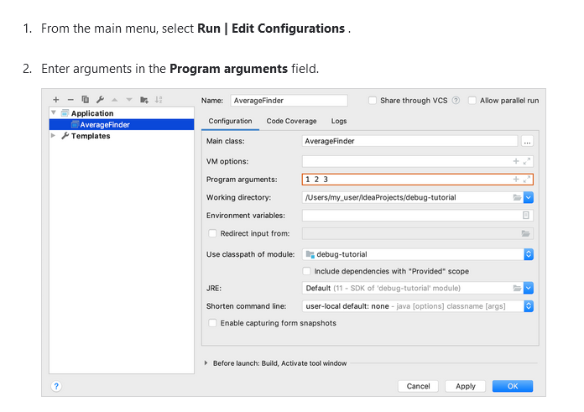
Debugging using the debugger tool provided by IntelliJ
Run the program in debug mode ﻿
Now let's start the program in debug mode.
Since we are going to pass arguments for running and debugging the program, make sure the run/debug configuration has these arguments in place.
05/01/2021
<number>

Slide 43
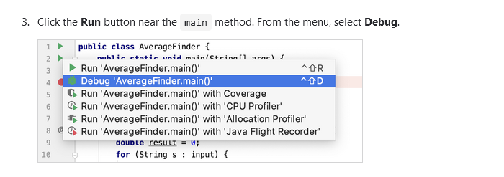
Debugging using the debugger tool provided by IntelliJ
Analyze the program state ﻿
After the debugger session has started, the program runs normally until a breakpoint is hit. When this happens, the line where the program paused gets highlighted and the Debug tool window appears.
05/01/2021
<number>

Slide 44
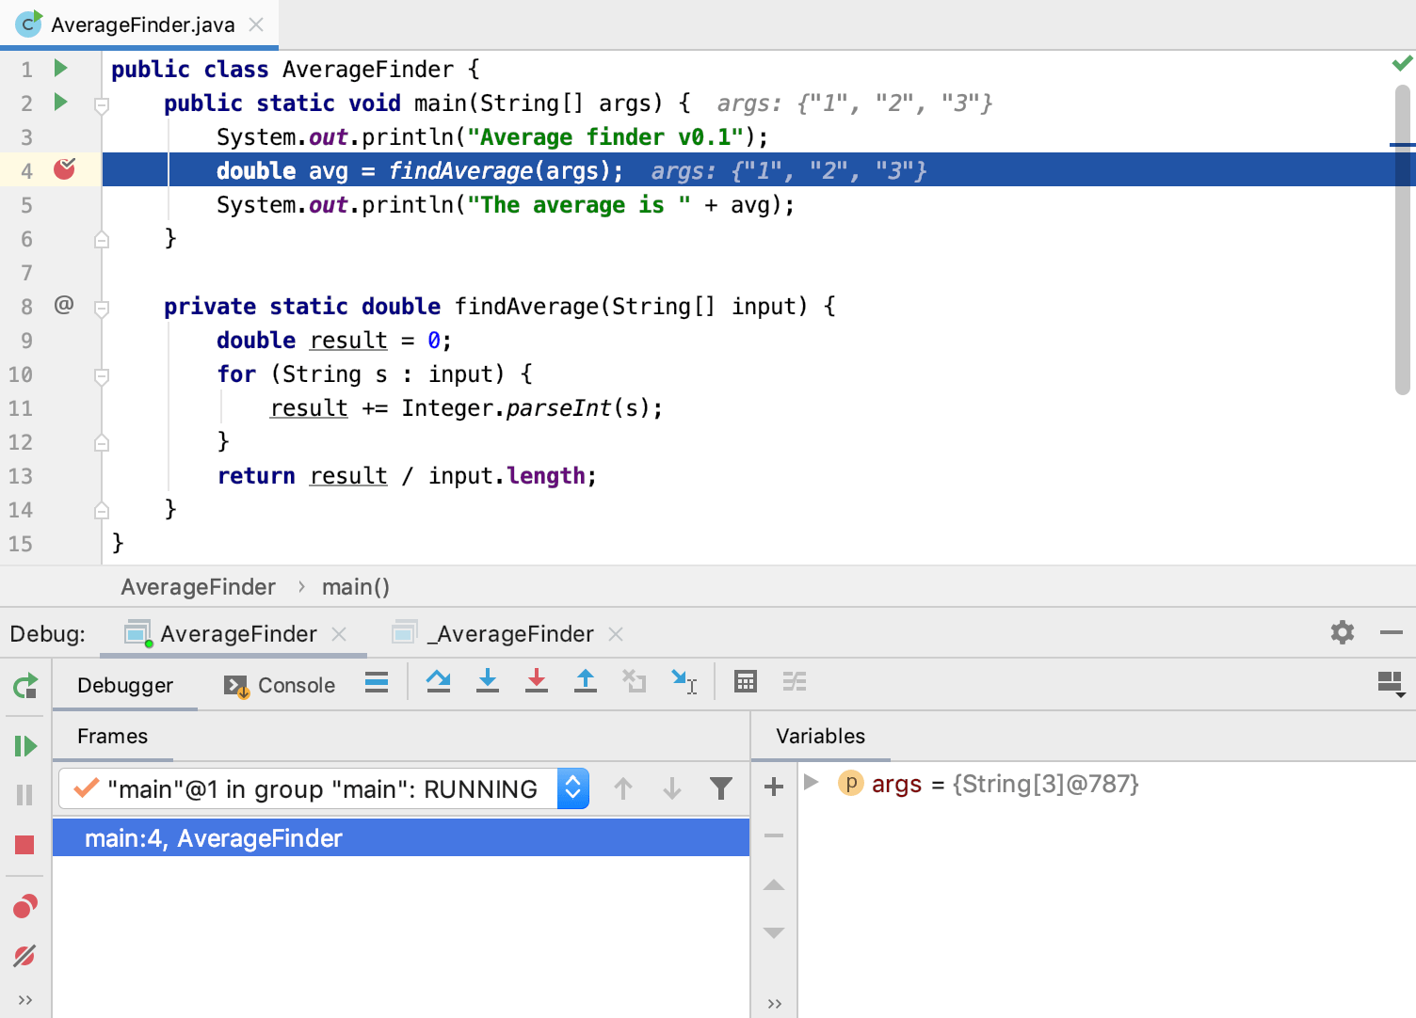
Debugging using the debugger tool provided by IntelliJ
The highlighted line has not been executed yet. The program now waits for further instructions from you. The suspended state lets you examine variables, which hold the state of the program.
05/01/2021
<number>

Slide 45

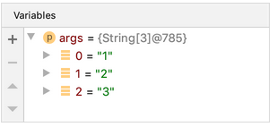
Debugging using the debugger tool provided by IntelliJ
As the findAverage method has not been called yet, all its local variables like result are not yet in scope, however, we can examine the contents of the args array (args is in scope for the main method). The contents of args are displayed inline where args is used:
You can also get information about all variables that are currently in scope in the Variables panel.
05/01/2021
<number>

Slide 46
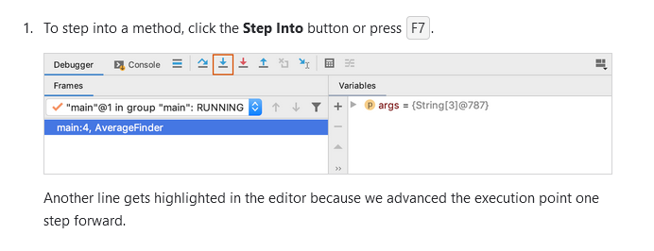
Debugging using the debugger tool provided by IntelliJ
Step through the program ﻿
Now that we are comfortable with the Debug tool window, it's time to step into the findAverage method and find out what is happening inside it.
05/01/2021
<number>

Slide 47
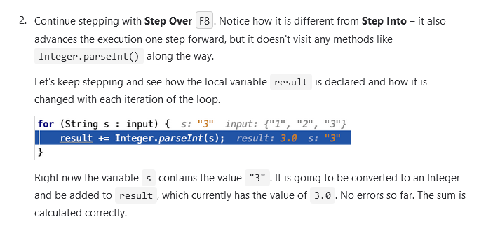
Debugging using the debugger tool provided by IntelliJ
05/01/2021
<number>

Slide 48
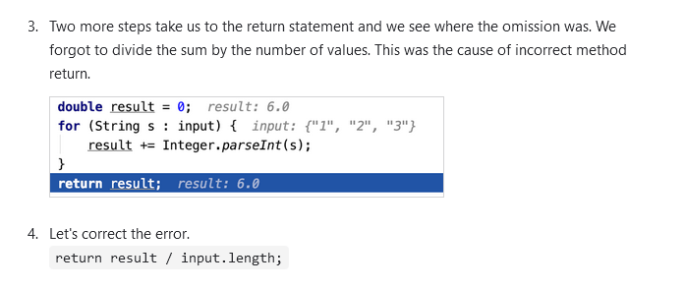
Debugging using the debugger tool provided by IntelliJ
05/01/2021
<number>

Slide 49
#LifeKoKaroLift
Thank You!
<number>
05/01/2021

